Slide 1

Web scraping to gain company insights
31/07/2023

Slide 2
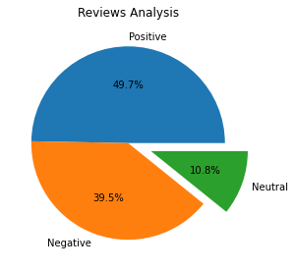
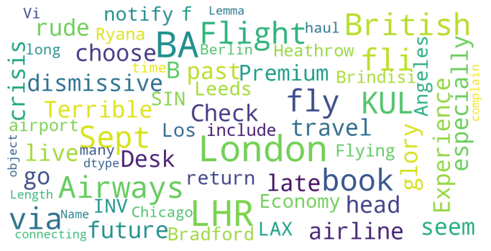
INSIGHTS FROM CUSTOMER REVIEWS
From cleaning 1000 reviews given by the customers, we obtained
Positive Reviews – 497
Negative Reviews - 395
Neutral Reviews – 108
Word cloud of keywords used in reviews

